Slide 1
Mediapipe Face recognition
以mediapipe實作臉部辨識功能之學習紀錄
製作:莊沛騰 mail : peiteng.chuang@gmail.com

Slide 2
環境設置
使用以下三個指令來安裝所需要的函式庫
pip install mediapipe
pip install tensorflow
pip install opencv-python

Slide 3
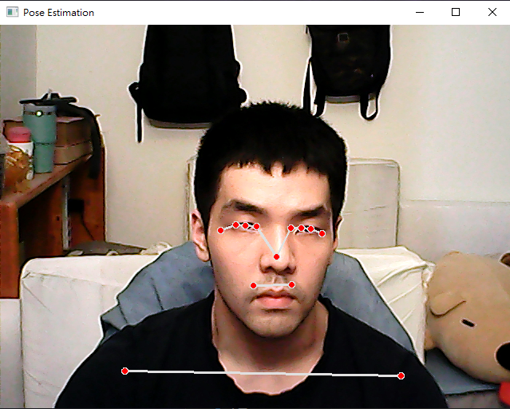
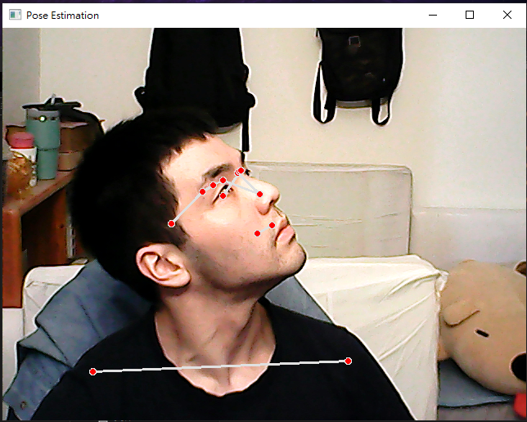
基礎模型()

Slide 4
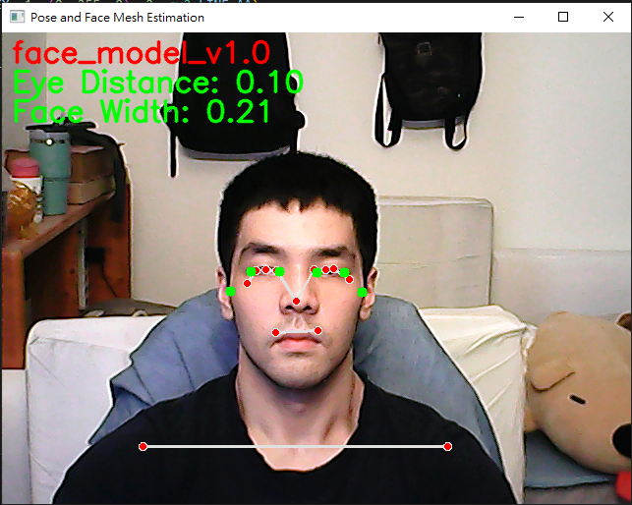
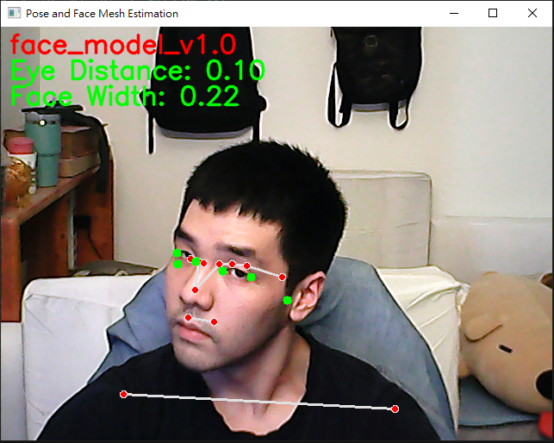
自定義臉部模型
(計算眼距、臉寬等等，使用face_mesh功能)

Slide 5
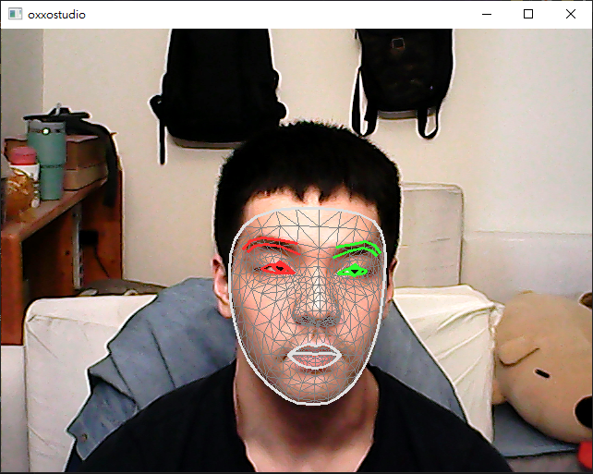
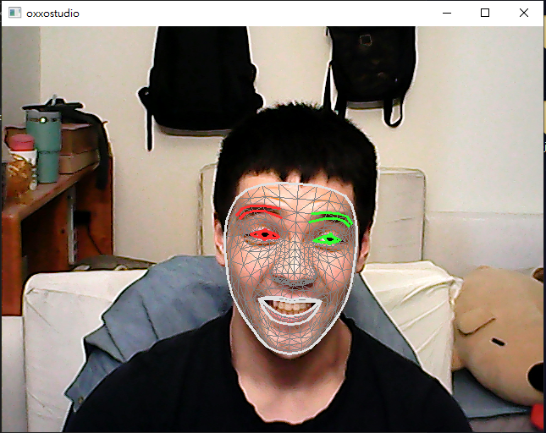
Face_mesh

Slide 6
初始化mediapipe pose
import cv2
import mediapipe as mp
mp_pose = mp.solutions.pose
pose = mp_pose.Pose()
mp_drawing = mp.solutions.drawing_utils

Slide 7
設置相機
# 開啟相機
cap = cv2.VideoCapture(0)
# 獲取攝像頭的幀寬和幀高
frame_width = int(cap.get(3))
frame_height = int(cap.get(4))
# 設定視頻編碼格式和保存路徑
fourcc = cv2.VideoWriter_fourcc(*'XVID')
out = cv2.VideoWriter('output.avi', fourcc, 20.0, (frame_width, frame_height))

Slide 8
拍攝並轉換
while cap.isOpened():
ret, frame = cap.read()
if not ret:
break
image = cv2.cvtColor(frame, cv2.COLOR_BGR2RGB)
results = pose.process(image)
if results.pose_landmarks:
mp_drawing.draw_landmarks(frame, results.pose_landmarks, mp_pose.POSE_CONNECTIONS)
out.write(frame)
cv2.imshow('Pose Estimation', frame)
if cv2.waitKey(10) & 0xFF == ord('q‘):
print("Detected 'q' key press. Exiting loop.")
break

Slide 9
別忘記釋放資源
cap.release()
out.release()
cv2.destroyAllWindows()

